Slide 1
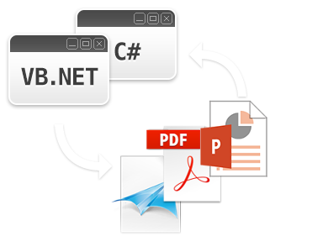
Welcome to GemBox.Presentation
a .NET component that enables developers to read, write, convert and print presentation files (PPTX, PDF, XPS and image formats) from .NET applications in a simple and efficient way.
The next slide shows tips how to get started

Slide 2
Hello World Example
When a component is installed, it is installed in GAC (Global Assembly Cache).
To use GemBox.Presentation, follow these steps:
Create a new .NET project (or use an existing one).
Use the Add Reference dialog to add a new reference to the DLL with a GemBox.Presentation name. It should be under the .NET tab.
Import a GemBox.Presentation namespace: using GemBox.Presentation; for C# or Imports GemBox.Presentation for VB.NET.
Set the license key to use GemBox.Presentation in Free mode as follows: ComponentInfo.SetLicense("FREE-LIMITED-KEY"); for C# or ComponentInfo.SetLicense("FREE-LIMITED-KEY") for VB.NET.
Now you can write an application-specific presentation processing code like the one below.
C# code
VB.NET code
// Create a new empty presentation.
var presentation = new PresentationDocument();
// Add a new empty slide.
var slide = presentation.Slides.AddNew(SlideLayoutType.Custom);
// Add a text box of size 5 x 5 cm in the top-left corner of the slide.
var textBox = slide.Content.AddTextBox(0, 0, 5, 5, LengthUnit.Centimeter);
// Add a paragraph with text content to the text box.
textBox.AddParagraph().AddRun("Hello World!");
// Save the presentation to PPTX and PDF file.
presentation.Save("Presentation.pptx");
presentation.Save("Presentation.pdf");
' Create a new empty presentation.
Dim presentation = New PresentationDocument()
' Add a new empty slide.
Dim slide = presentation.Slides.AddNew(SlideLayoutType.Custom)
' Add a text box of size 5 x 5 cm in the top-left corner of the slide.
Dim textBox = slide.Content.AddTextBox(0, 0, 5, 5, LengthUnit.Centimeter)
' Add a paragraph with text content to the text box.
textBox.AddParagraph().AddRun("Hello World!")
' Save the presentation to PPTX and PDF file.
presentation.Save("Presentation.pptx")
presentation.Save("Presentation.pdf")

